Slide 1
WOUND
Dr. Santosh Dobhal
Dept. Of Cardiovascular & Respiratory Physiotherapy
MGM Institute Of Physiotherapy
Chh. Sambhajinagar

Slide 2
CONTENT
Types of wound
Stages of wound healing
Assessment of wound

Slide 3
A wound is a type of injury which happens relatively quickly in which skin is torn, cut, or punctured (an open wound), or where blunt force trauma causes a contusion (a closed wound)

Slide 4
Types of wound
Contusion – bruising or haemorrhage. Caused by a blow from something blunt
• Abrasion – caused by skin being scraped along a hard surface
• Incision – clean cut/surgical. Skin, soft tissues and muscle may be severed
• Laceration – jagged edges e.g. from teeth, claws, barbed wire.

Slide 5
TYPES OF WOUND
Puncture – small entry. May have some internal damage and can become infected
• Tear/Avulsion – skin and soft tissue partially or completely torn away
• Cavity – chronic, open wound
e.g.pressure sores, Arterial or venous ulcers

Slide 6
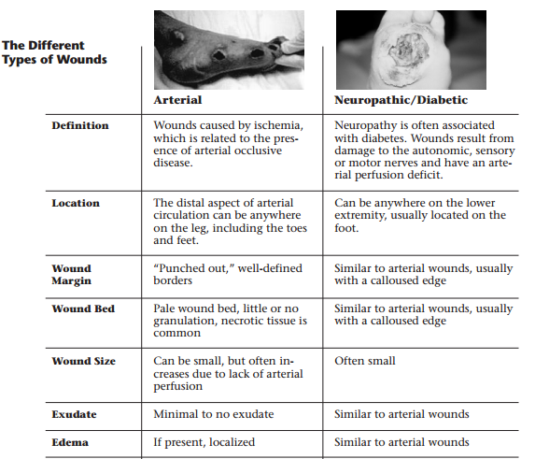

Slide 7
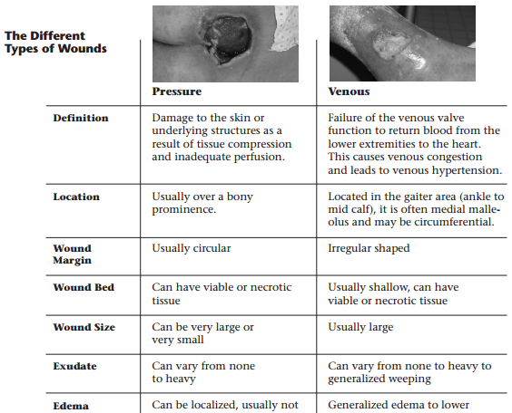

Slide 8
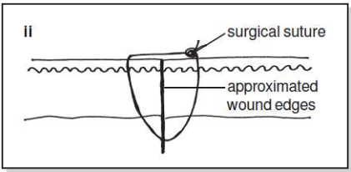
Wound healing
Healing by Primary Intention –
All layers are closed. The incision that heals by first intention does so in a minimum amount of time, with no separation of the wound edges, and with minimal scar formation.

Slide 9
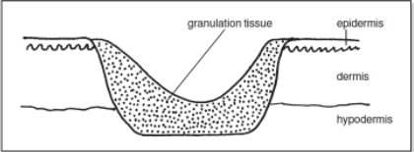
Healing by Secondary Intention –
Deep layers are closed but the superficial layers are left to heal from the inside out. Healing by secondary intention is appropriate in cases of infection, excessive trauma, tissue loss, or imprecise approximation of tissue.
Healing by Tertiary Intention –
Also referred to as delayed primary closure.

Slide 10
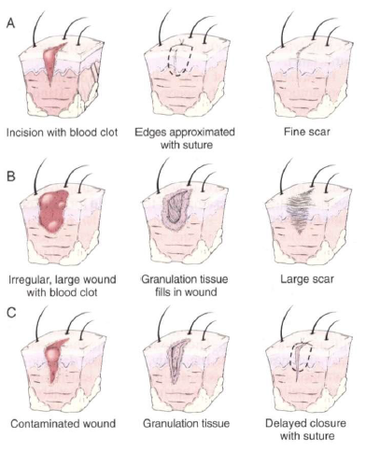

Slide 11
Stages of wound healing
Inflammatory Phase –
Inflammation occurs when the damaged endothelial cells release cytokines that increase the circulating lymphocytes.
Histamine, serotonin, and kinins cause vessel contraction (thromboxane), decrease in blood loss, and act as chemotactic factors for neutrophils, the most abundant cells in the initial 24 hour period.

Slide 12
Proliferative Phase –
It occurs next after the neutrophils have removed cellular debris and release further cytokines acting as attracting agents for macrophages.
Fibroblasts now migrate into the wound and secrete collagen type III.
Angiogenesis occurs by 48 hrs.
Collagen fiber production normally begins around the fifth day after injury
The secretion of collagen, macrophage remodeling and secretion, and angiogenesis continues for up to 3 weeks.
The greatest increase in wound strength occurs during this phase.

Slide 13
Maturation Phase –
It is the final phase and starts from the 3rd week and continues for up to 9 – 12 months.
This is where collagen type III is converted to collagen I, and the tensile strength continues to increase up to 80 % of normal tissue.

Slide 14
Wound Healing
1) Inflammatory Phase
Vasoconstriction
Phagocytosis
2) Proliferation Phase
Epithelialization
Wound Contraction
3) Maturation Phase
Collagen Synthesis/ Lysis
Collagen fiber orientation
Vasodilation
Clot formation
Fibroplasia/ Collagen Formation
Neovascularization
Healed Injury

Slide 15
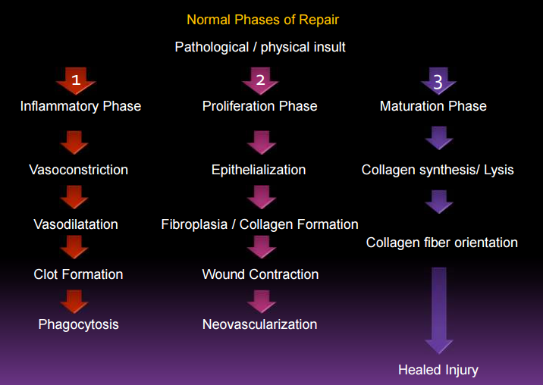

Slide 16
Wound Assesswent
Location
Shape
Size
Depth – sterile cotton tipped applicator into the wound
Undermining – area under intact skin
Wound bed
Wound Edges

Slide 17
Wound Assessment
Drainage- serous, seroguineous, Sanguineous, sero-purulent, purulent
Wound odor-
Periwound Skin- Color, texture, skin temperature,
Pain assessment
Wound photography

Slide 18
Techniques for measuring wounds

Slide 20
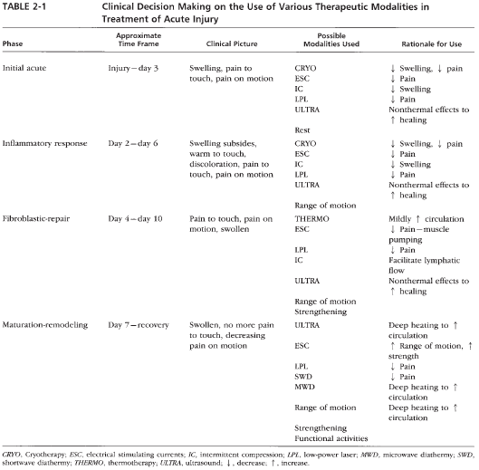

Slide 21
Electro therapeutic modalities for wound healing
Therapeutic current
Ultrasound
LASER
Ultraviolet Radiation

Slide 22
Therapeutic current for Tissue Healing
Electrical stimulation is thought to promote tissue healing by attracting appropriate cell types to the area, activating these cells by
Altering cell membrane function,
Modifying endogenous electrical potential of the tissue in concert with healing potentials,
Reducing edema,
Enhancing antimicrobial activity,
Increasing protein synthesis and cell migration, promoting circulation, and
Improving tissue oxygenation

Slide 23
Mechanism of Action
Electrical stimulation is thought to promote tissue healing by attracting appropriate cell types to the area, activating these cells by altering cell membrane function, modifying endogenous electrical potential of the tissue in concert
With healing potentials, reducing edema, enhancing antimicrobial activity, increasing protein synthesis and cell migration, promoting circulation, and improving tissue oxygenation

Slide 24
Specific cells, including neutrophils, macrophages, lymphocytes, and fibroblasts, can be attracted to an injured healing area by an electrical charge because the cells carry a charge

Slide 25
Activated neutrophils, which are present when a wound is infected or inflamed, are attracted to the negative pole, whereas inactive neutrophils are attracted to the positive pole.
Macrophages and epidermal cells are also attracted to the positive pole, whereas lymphocytes, platelets, mast cells, keratinocytes, and fibroblasts are attracted to the negative pole be used for treatment of infected or inflamed wounds and the positive electrode be used if necrosis without inflammation is present, and when the wound is in the proliferative stage of healing.

Slide 26
In general, the negative electrode should be used to promote healing of inflamed or infected wounds and the positive electrode should be used to promote healing of wounds without inflammation.
Electrical stimulation attract cells to an injury site, it has also been shown to enhance fibroblast replication and increase the synthesis of DNA and collagen by fibroblasts.

Slide 27
Fibroblasts and the collagen they produce are essential for the proliferation phase of tissue
healing.
It is proposed that the electrical current pulse triggers calcium channels in the fibroblast cell membrane to open. The open channels allow calcium to flow into the cells, increasing intracellular calcium levels to induce exposure of additional insulin receptors on the cell surface. Insulin can then bind to the exposed receptors, stimulating the fibroblasts to synthesize collagen and DNA.

Slide 28
This sequence of events is voltage dependent, with maximum calcium influx and protein and DNA synthesis occurring with high-volt pulsed current (HVPC) with a peak voltage in the range of 60 to 90 V

Slide 29
Electrical stimulation may also promote tissue healing through antimicrobial activity. Monophasic currents, both microampere level direct current (DC) and HVPC, have been shown to kill bacteria in vitro, whereas alternating current (AC) has not been found to affect bacterial growth or survival

Slide 30
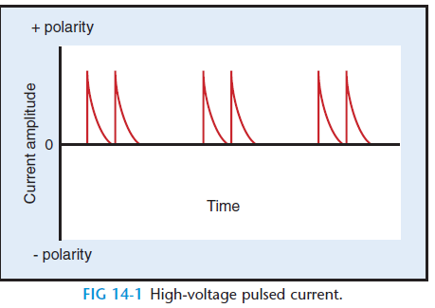
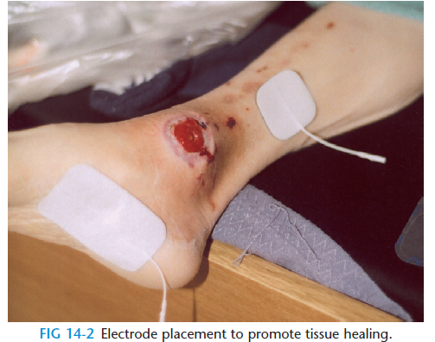
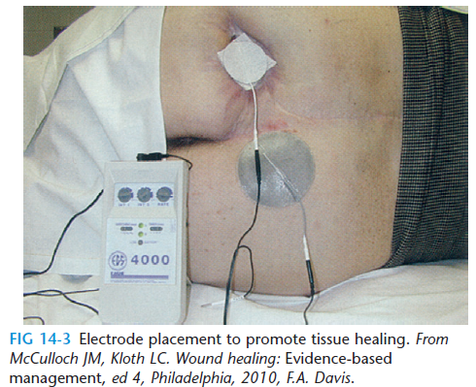

Slide 31
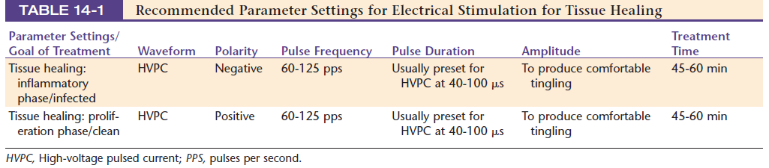

Slide 32
Electrical Stimulation For Wound Haeling
Altering cell membrane function,

Slide 33
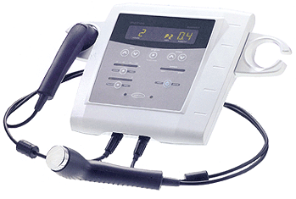
Ultrasound
Ultrasound is a method of stimulating the tissue beneath the skin's surface using very high frequency sound waves, between 800,000 Hz and 2,000,000 Hz, which cannot be heard by humans.

Slide 34
US PHYSIOLOGICAL Effects
Thermal effect
Increase in local temp. causes hyperaemia.
Non thermal effect
1. Cavitation- formation of tiny gas bubbles in the tissues as result of US vibration. Causes localized unidirectional fluid movement around the vibrationg bubble
2. Acoustic streaming- Steady circulatory flow due to radiation torque Increases tissue permeability

Slide 35
US for wound healing
Inflammatory Phase –
US Causes degranulation of mast cells, resulting in release of histamine.
Proliferative Phase –
Effects fibroblasts and stimulates them to secrete collagen. This can accelerate the process of wound contraction and increase tensile strength of the healing tissue.
Maturation Phase –
Effects collagen re-orientation and improves tissue elasticity and strength.

Slide 36
Ultrasound effect on wound healing
Inflammatory phase-
Stable cavitations and acoustic streaming appear to increase calcium ion diffusion across cell membrane.
Causes degranulation of mast cells, resulting in release of histamine and other factors in this way US have potential to accelerate normal resolution of inflammation .

Slide 37
Ultrasound effect on wound healing
This acceleration also be due to gentle agitation of the tissue fluid which may increase the rate of phagocytosis and the movement of particle and cells.

Slide 38
Ultrasound effect on wound healing
Proliferative stage/Granulation stage-
Connective tissue framework is laid down by Fibroblast activity and angiogenesis
US stimulate them to secrete more collagen that increases the tensile strength of the connective tissue.

Slide 39
Ultrasound effect on wound healing
Remodeling phase
Last from months or years until the new tissue is as near in structure as possible to the original tissue
US improves extensibility of mature collagen such as is found in scar tissue
By reorientation of the fibers (remodelling) which leads to greater elasticity without loss of strength.

Slide 40
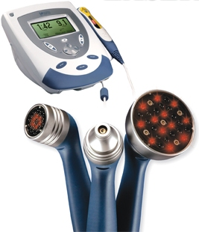
LASER
(Light Amplification from the stimulated emission of radiation)

Slide 41
LASER
It was found that low dosages ( 10 J/cm2) of radiation from low-output lasers had a stimulatory action on metabolic processes and cell proliferation compared to incandescent or tungsten light.

Slide 42
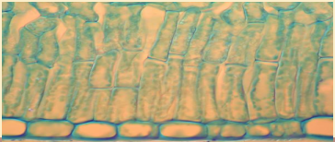
Mechanism of action
PHOSPHO – LIPID GATE AND COHERENT LIGHT –
The cell membrane “oscillates” due to the coherence of waveforms and thus increases cell membrane permeability

Slide 43
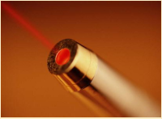
Benefits of laser
ATP production
Collagen synthesis
Wound healing
Pain reduction
Increase immune response
And there is no sensation to the patient except possibly the sensation of a slight breeze.

Slide 44
LASER For wound healing
Inflammatory phase
Evidence also suggests that red (He-Ne) laser irradiation activates T and B lymphocytes, enhancing their ability to bind bacteria and that laser light promotes degranulation of mast cells and synthesis and release of chemical mediators of fibroblast proliferation by macrophages.

Slide 45
LASER For wound healing
Proliferation phase -
Laser and LED light in the red to IR wavelength range can also stimulate proliferation of various cells involved in tissue healing, including fibroblasts, keratinocytes, and endothelial cells
Laser and light therapy is also thought to enhance tissue healing by promoting collagen production, likely by stimulating production of mRNA that codes for procollagen.

Slide 46
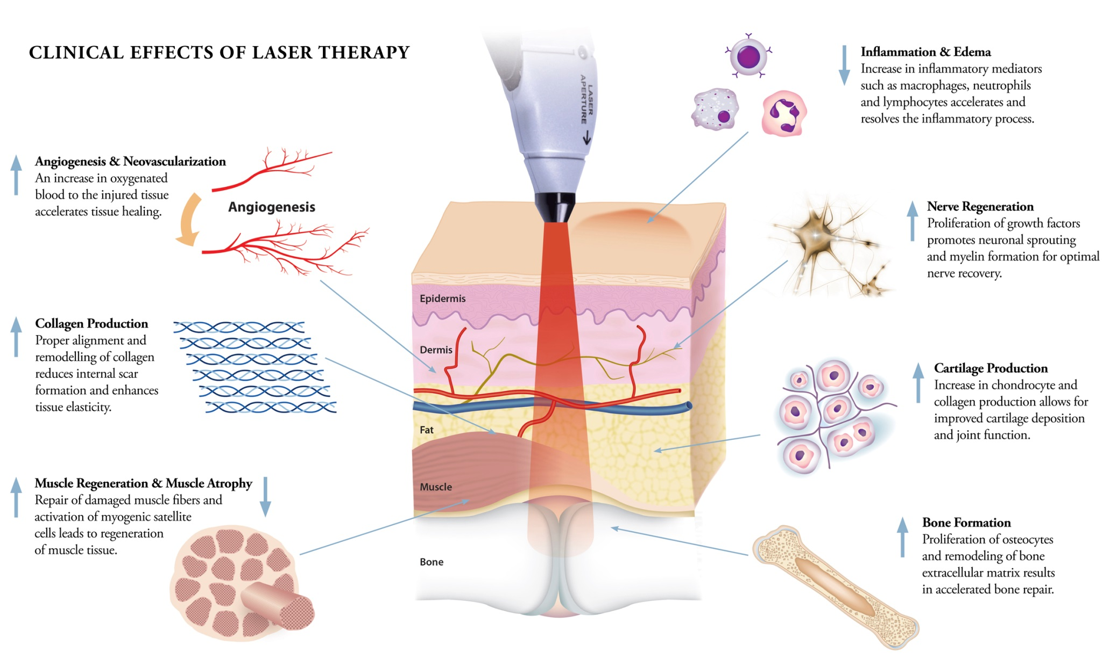

Slide 47
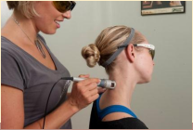
LASER for wound healing
LASERs work by producing short pulses of intense light that pass harmlessly through the top layers of the skin to be selectively absorbed by the inflammatory tissue.
This laser energy causes the inflammatory tissue to fragment into smaller particles that are then removed by the body’s immune system.
The laser selectively targets the inflammatory tissue without damaging the surrounding cells.

Slide 48
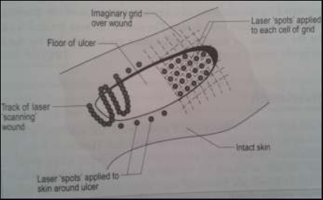
Application and dosage
Wound Margins
Direct contact
1 – 2 cms from edges
4 – 10 J/ cm²
Wound Bed
Non Contact
1 – 5 J/ cm²

Slide 49
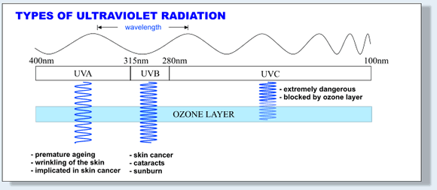
Ultraviolet radiation
Ultraviolet (UV) light is electromagnetic radiation with a wavelength shorter than that of visible light, but longer than X - rays, that is, in the range between 400 nm and 10 nm.

Slide 50
UVR for Wound Healing
The use of UVR To treat chronic wound is most often based on bactericidal effect and on the erythemal response. That stimulates the healing process by exfoliation and repair

Slide 51
Name | Abbrevation | Wavelength Range (in nanometers) | Energy per photon (in electronvolts) | Notes/ alternative names
Ultraviolet | UV | 400 – 100 | 3.10 – 12.4 eV
Ultraviolet A | UVA | 400 – 315 | 3.10 – 3.94 eV | Long wave, black light
Ultraviolet B | UVB | 315 – 280 | 3.94 – 4.43 eV | Medium wave
Ultraviolet C | UVC | 280 – 100 | 4.43 – 12.4 eV | Short wave, germicidal

Slide 52
UVR C (100 – 280 nm) is the frequency band most commonly used because it,
Enhances epithelialization
Destroys bacteria
Causes minimal erythema
And is absorbed almost equally by all skin colours
Antibiotic effects of UVR C is used for sterilization of wound
UVR A and UVR B is known to,
- Promote granulation tissue
- Remove slough
Stimulate epidermal growth

Slide 53
UVR B exposure induces the production of vitamin D in the skin at the rate of up to 1000 IU’s per minute.
The majority of positive health effects are related to this vitamin.
It has regulatory roles in calcium metabolism (which is vital for normal functioning of the nervous system, as well as for bone growth and maintenance of bone density), immunity, cell proliferation, insulin secretion and blood pressure.

Slide 54
Dosage (for ulcers with UVR c lamp)
Surface Appearance | Dosage Level
Clear exudate, red “bubbled” granulation, edges almost level with skin | E1
Cloudy or purulent exudate, pale or grayish colour, not granulating, edges vertical | E3
Dense yellow surface, necrotic debris, ulcer base not visible, edges vertical or undetermined | E4
Adherent black crust | 2E4

Slide 55
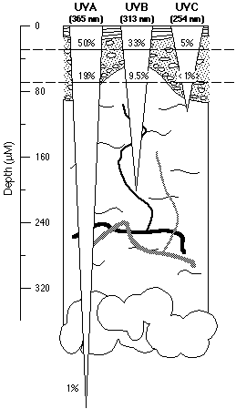
UVR penetration depths

